Slide 1
Team Presentation: BLACKWELL ELECTRONICS
Vani BV, Jessica Williams, Saad Yousef, Khristine Queja, Clayton Ehrlich

Slide 2
Blackwell Electronics Data Analytics
The Blackwell Data Analytics team has been tasked by Sales and Marketing to analyze historical sales and profitability data to help guide upcoming business decisions.
Task 2: Predicting Customer Brand Preference
Task 3: Predicting New Product Profitability
Task 4: Discover Association between Products
Additional ways to use Data Mining to answer questions across the business:
Sales and Marketing: Identifying sales trends, development of marketing campaigns, customer loyalty, and profitability
Research and Development: Product enhancements, where to focus funds and manpower to get the best ROI
General and Administrative: Employee characteristics can contribute to recruiting decisions as well as continued learning opportunities for existing employees to maximize individual contributions to the business

Slide 3
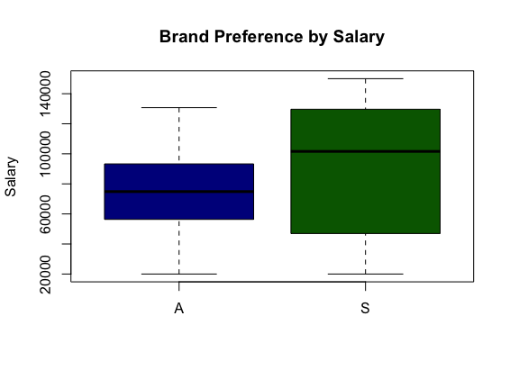
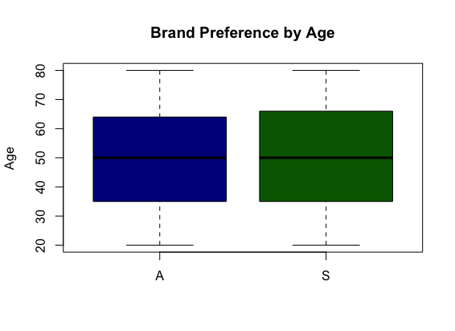
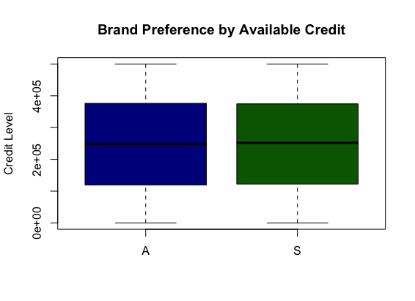
Predicting Brand Preference: Analyzing the Completed Surveys

Slide 4
Product Preference Analysis
Notes:
With our five attributes, we wanted to see whether any attribute indicated an irregular buying pattern. In other words, did any attribute give us any indication that the entire group, or a segment within that attribute, is more likely to purchase one product of the other.
We’ll first look at the attributes that didn’t indicate any irregularities. These attributes with no irregularities are Region, Car Owned, Age Group, and Education Level. Looking at data within each attribute, we can see that for the most part each segment within the attribute population, no irregular preferences are present.
However that was not the case with our Salary Range data. <next slide>

Slide 5
What attribute tells us the most?
Notes:
Looking at our data from the perspective of Salary range we see a lower than expected preference amount for Acers for the $20k-30k and $110k-150k salary ranges. The Acer also had a higher than normal preference for the $50k-$100. From these we should target our Acer computers to our middle income customers and our Sony computers to our low and high-income customers.
Now we sell many computers, netbooks, and laptops and will pass it on to Jessica and Clayton to discuss which products will net us the most profit.

Slide 6
Predict Sales Performance and assess Impact of reviews by product
OVERVIEW:
Sales has requested that the Analytics team run additional analysis on historical sales data this time including and focusing on product type to better understand how specific product types perform against eachother and to determine:
Sales performance of four different product types:
PC
Laptops
Netbooks
Smartphones
Assess the impact of service reviews and customer reviews on each product type

Slide 7
Predict Sales Performance by product and assess impact of reviews by product (Cont’d)
APPROACH:
Review the data provided. As with the prior analysis on the provided data set, it was determined that some attributes were too closely related, and risked triggering false or extreme results:
Attributes excluded from Model:
5 Star Reviews
4 Star Reviews
3 Star Reviews
2 Star Reviews
1 Star Reviews
Due to the exclusion of the Customer Review attributes during the modeling and predicting phases, estimates were made based off of the averages for each product type and rating from the existing product set data and applied these averages to our results for analysis

Slide 8
Sales performance Predictions by product
Findings:
Despite having the highest predicted sales volume, Netbook predicted sales came in second behind Laptop predicted sales due to per unit pricing
Netbook is the most well rounded product set, with the highest predicted sales volume and second highest predicted sales
Smartphone is the least profitable product set, with the lowest predicted sales despite the second highest predicted sales volume

Slide 9
Impact of Service reviews by product
Findings:
Service Reviews show no noticeable correlation to predicted volume or predicted sales by Product Type
It may prove beneficial to find a way to motivate buyers to participate in the review process to get a wider set of responses for analysis

Slide 10
Impact of Estimated Customer reviews by product
Findings:
Like Service Reviews, Customer Review estimates do not appear to be a driver behind product sales
With Smartphones being utilized more and more in place of full fledged computers, and also being upgraded/replaced more often, it is not surprising that the most total ratings occurred for that product type

Slide 11
What’s Next?
Our next step was to determine whether it would be a sound investment to acquire Electronidex. To do this we need to determine:
What are their sales? How much did they sell?
What products sell best?
What products sell the least?
What combinations of products sell well together?

Slide 12
Analysis of Electronidex’s transactions
Blackwell Electronics is considering to acquire Electronidex and wants to identify purchasing
patterns that will provide insight into Electronidex's clientele
Received one month’s worth of Electronidex’s online transactions (9,835 transactions, 125 products)
Removed duplicate transactions (6,889 transactions)
Identified most frequently purchased items (For example, top5)
Product Name | Number of transactions
iMac | 2,217
HP Laptop | 1,764
CYBERPOWER Gamer Desktop | 1,472
Apple Earpods | 1,363
Lenovo Desktop Computer | 1,340

Slide 13
Analysis of Electronidex’s transactions (Continued…)
Identified number of items purchased in a transaction (For example, number of
transactions with three items)
Number of items | Number of transactions
3 | 1,183
4 | 1,006
2 | 878
5 | 856
6 | 646
25, 26, 29, 30 | 1
23, 27 | 3

Slide 14
Recommender SYSTEM
What is the ‘recommender system?’
A modelling technique based on the theory that if you buy a certain item or group of items, you
are more (or less) likely to buy another item or group of items
Can be applied to any process, for example, to uniquely identify customer service
representatives and record information about their activities
Process of recommender system:
Used Apriori algorithm
Found three rules
iMac (32.18% of the times the customer is most likely to purchase this item)
iMac -> HP Laptop (41.55%)
HP Laptop -> iMac (33.06%)

Slide 15
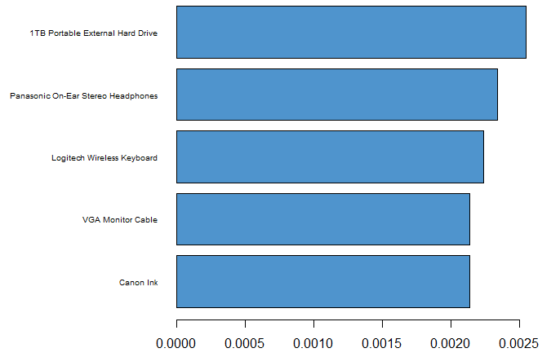
Recommendations
It’s beneficial for Blackwell to acquire Elecronidex
Keep selling the top five products of Elecronidex
Should mix Blackwell’s products with the top five Electronidex’s products so that customers
can buy Blackwell’s as well as Electronidex’s products together
After acquisition Blackwell should remove the
products that were in less number of
transactions, for example, the graph here
shows that Cannon Ink appeared in
0.2% of transactions in the total number of
6,889 transactions

